Slide 1

OSeMOSYS
  www.osemosys.org
  Howells, M., et al. (2011). OSeMOSYS: The Open Source Energy Modeling System: An introduction to its ethos, structure and development, Energy Policy, 39(10), p.5850-5870.
  Model generator converting the energy system structure represented by equations into a matrix to be solved by specific solvers
    Linear optimisation
    Freely available and Open source
    Deterministic
    Dynamic
    Perfect foresight
    Paradigm comparable to MESSAGE and TIMES

Slide 2
OSeMOSYS in the modelling suite

Slide 3
What does OSeMOSYS do?
It determines the energy system configuration with the minimum total discounted cost for a time domain of decades, constrained by:
Demand for energy (e.g. electricity, heating, cooling, km-passengers, etc.) that needs to be met
Available technologies and their techno-economic characteristics
Emission taxations and generation targets (e.g. renewables)
Other constraints (e.g. ramping capability, availability of resources, investment decisions, etc.)

Slide 4
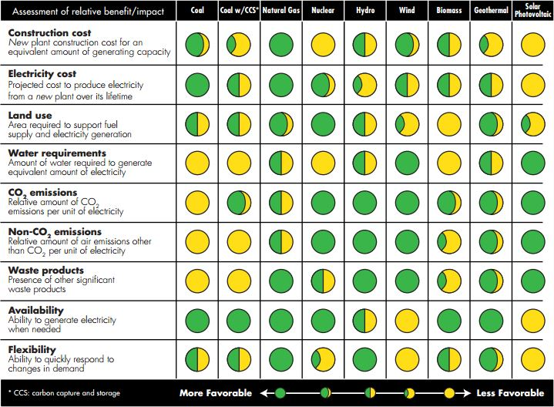
What does OSeMOSYS do?
  Technologies compete to gain a share in the energy supply, based on:
  a)their characteristics (e.g. cost, life time, efficiency etc);
  b) other constraints (e.g. demand, min renewable generation, emissions, use of resources, etc).

